Slide 1
project I
Pattern Recognition– winter 2017
Vatsala Sharma, 374843
Mayesha Tasnim, 374098
Chandan Acharya, 373970
Rahul Lao, 374021
Devendra Hupri, 374022
Rakesh Lagare, 374183
Vinay Pyati, 374182

Slide 2
tasks
1.1 – Plotting Data without Outliers
1.2 – Fitting a Normal Distribution to 1D data
1.3 – Fitting a Weibull Distribution to 1D data
1.4 – Drawing Unit Circles
1.5 – Estimating the Dimension of Fractal Objects in an Image

Slide 3
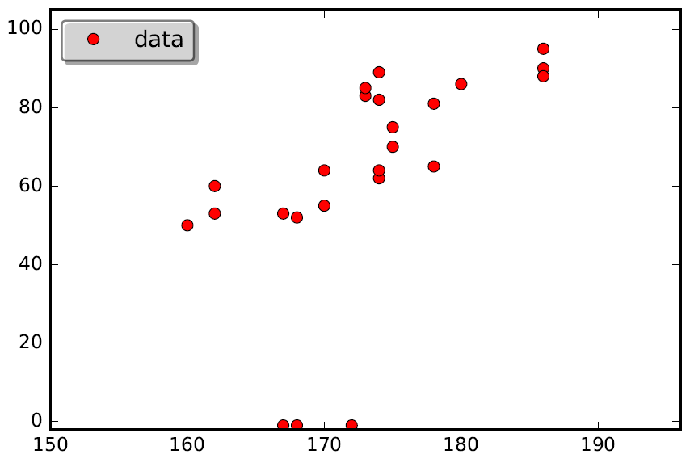
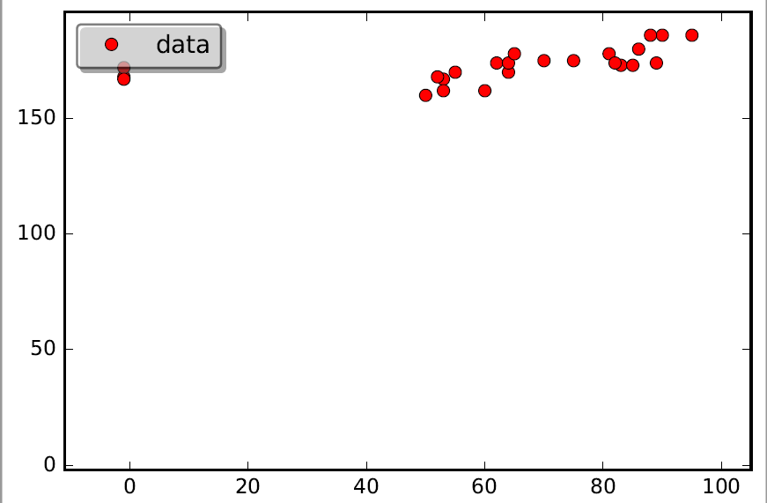
Task 1.1 – Plotting Data without Outliers
Weight (kg)
Height (cm)
Height (cm)
Weight (kg)
Weight and Height Data with Outliers

Slide 4
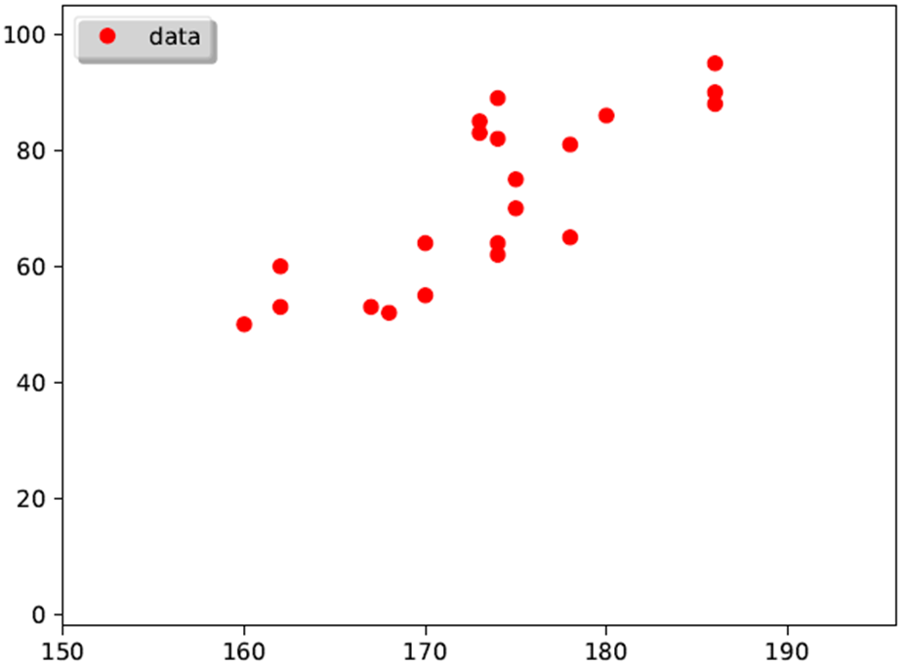
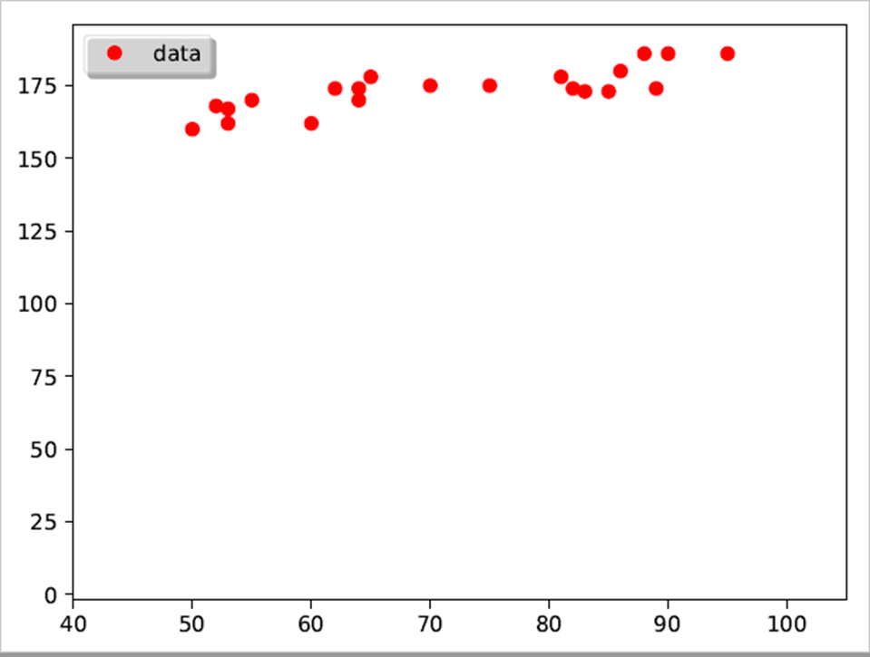
Task 1.1 – Plotting Data without Outliers
Non negative values are copied from the data and stored in 1D arrays and then plotted
Height (cm)
Weight (kg)
Height (cm)
Weight (kg)
Weight and Height Data without Outliers

Slide 5

Task 1.2 – Fitting a Normal Distribution to 1D data
Plot the data and a normal distribution for body weight & height
Calculated the Mean (μ) and Standard Deviation (σ) for data set.
Computed probability density of normal distribution:
Plotted the normal distribution characterising the density of data points

Slide 6
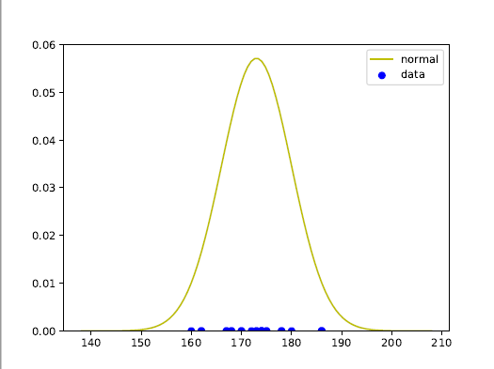
Task 1.2 – Fitting a Normal Distribution to 1D data

Slide 7
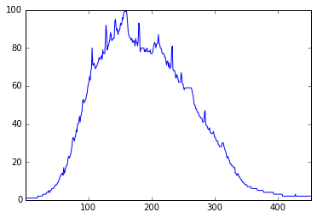
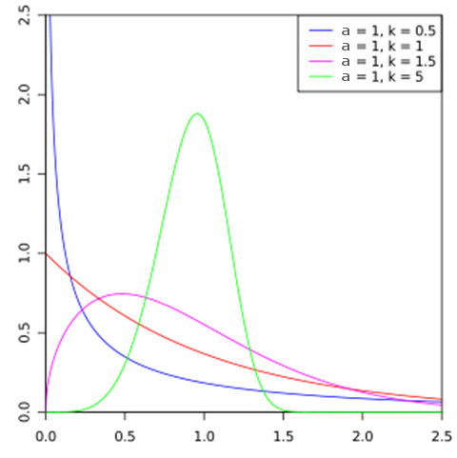
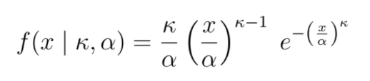
Task 1.3 – fitting a Weibull distribution to 1-D data
Given 1-D data
Weibull Distribution

Slide 8
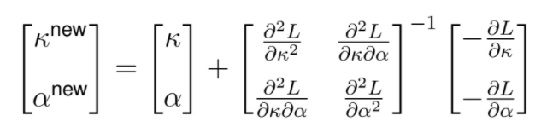
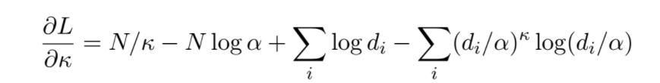
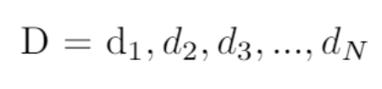



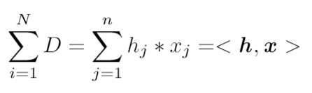
Task 1.3 – fitting a Weibull distribution to 1-D data
Determining k and a iteratively:
where
.
.
.
Summations over data points:

Slide 9
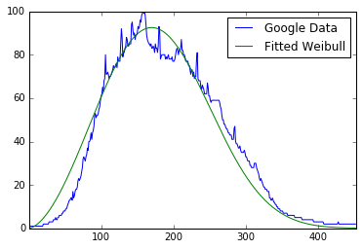
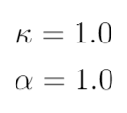
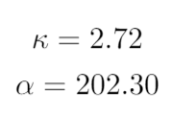
Task 1.3 – fitting a Weibull distribution to 1-D data
Initialized values:
After 20 iterations:

Slide 10
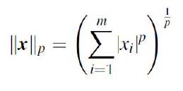

1.4 – Drawing Unit Circles
Plot the R² unit circle considering the L_{p} norm for p=0.5
L_{p} norm of x (when P >= 1):
When 0 < p < 1
The metrics is given as

Slide 11
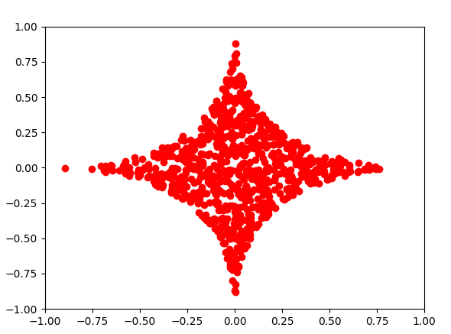
1.4 – Drawing Unit Circles
Unit Circle with p=0.5

Slide 12
Task 1.5 – Estimating the Dimension of Fractal Objects in an Image
A fractal is an abstract, mathematical object that exhibits similar patterns across all scales
zooming in onto a fractal reveals similar structures
Sierpenski triangle

Slide 13
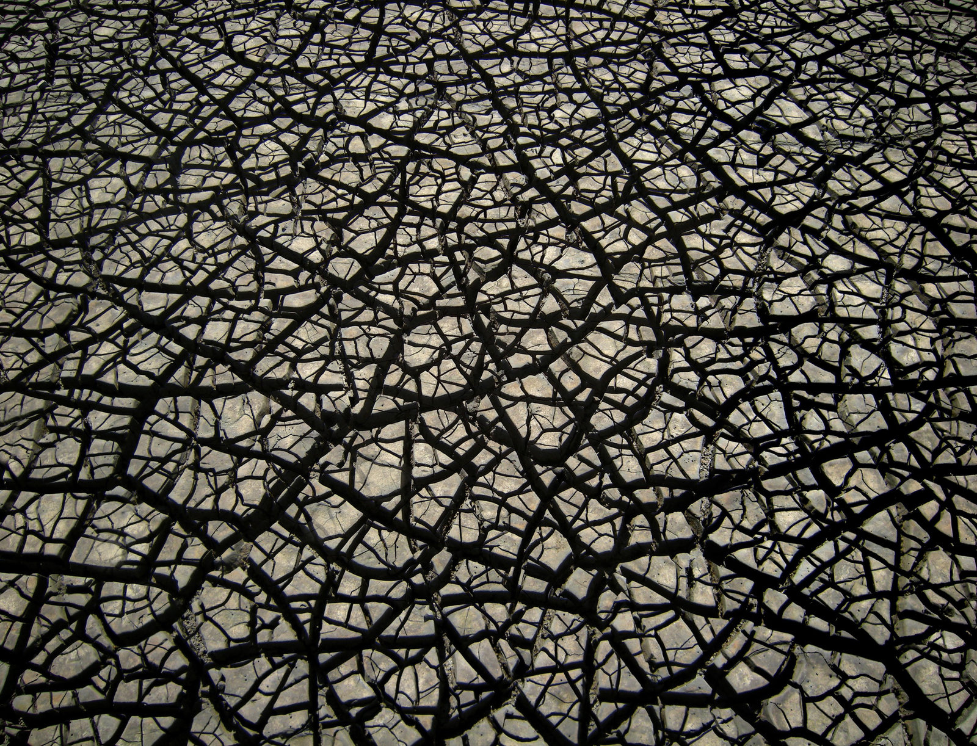
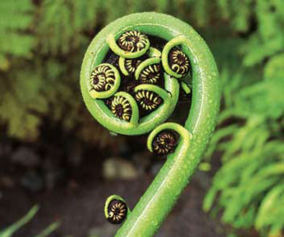
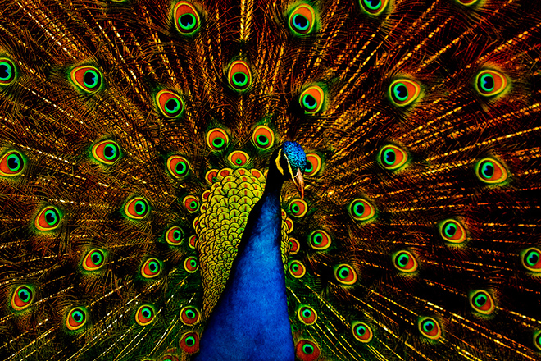
Task 1.5 – Estimating the Dimension of Fractal Objects in an Image
Fractals in Nature

Slide 14
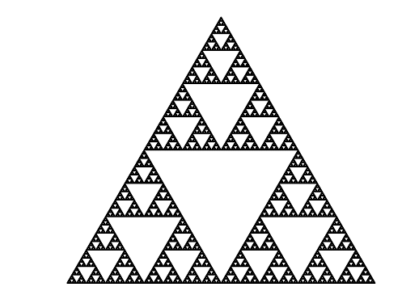


Task 1.5 – Estimating the Dimension of Fractal Objects in an Image
For a perfect fractal,
Fractal Dimension, D = $−\frac{\log{n}}{\log{s}}$
Where
s = scale factor of shrunken structure (0 < s < 1)
n = copies of shrunken structure needed to cover original
For Sierpenski triangle
D $≈\text{1.58}\text{5}$

Slide 15
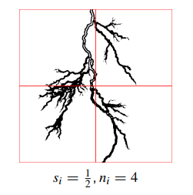
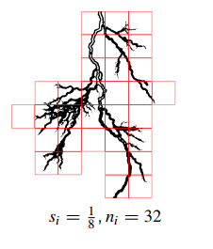
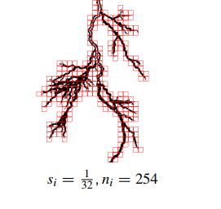
Task 1.5 – Estimating the Dimension of Fractal Objects in an Image
Box Counting method for calculating fractal dimension of an object inside an image,

Slide 16
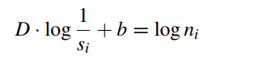
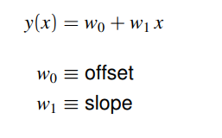
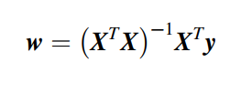



Task 1.5 – Estimating the Dimension of Fractal Objects in an Image
Following the model for perfect fractals, box counting dimension of a fractal is
We can re-imagine this equation as
$$≈\text{D}$$
$$\log{1/s_{i}}$$
$$\log{n_{i}}$$
Given a set of and , we can fit a line through the data using

Slide 17

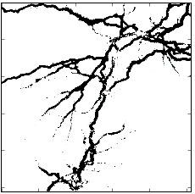
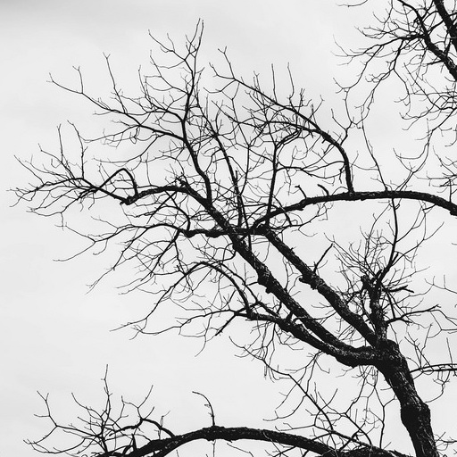
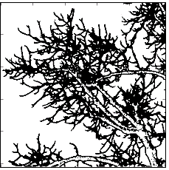
Task 1.5 – Estimating the Dimension of Fractal Objects in an Image
s_{i} | ½ | ¼ | 1/8 | 1/16 | 1/32 | 1/64 | 1/127
n_{i} | 4 | 14 | 45 | 147 | 404 | 1064 | 2905
s_{i} | ½ | ¼ | 1/8 | 1/16 | 1/32 | 1/64 | 1/127
n_{i} | 4 | 16 | 61 | 218 | 777 | 2679 | 8685

Slide 18
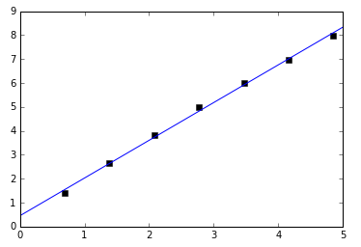
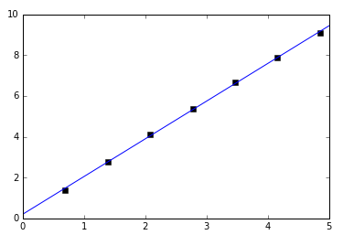






Task 1.5 – Estimating the Dimension of Fractal Objects in an Image
D $≈\text{1.5}\text{77}$
D $≈\text{1.}\text{846}$
$$\log{n_{i}}$$
$$\log{n_{i}}$$
$$\log{1/s_{i}}$$
$$\log{1/s_{i}}$$

Slide 19
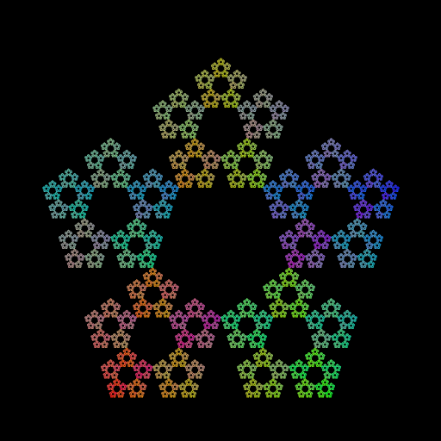
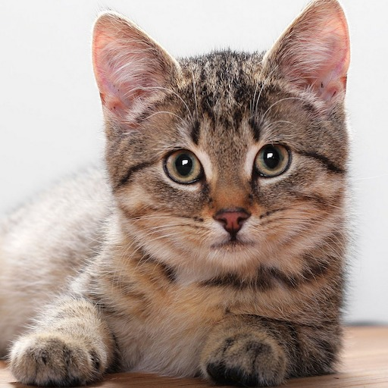


Task 1.5 – Estimating the Dimension of Fractal Objects in an Image
D $≈\text{1.}\text{66}$
D $≈\text{1.}\text{842}$

Slide 20
Thank you!

